Slide 1
Cessna C172 Systems Intro
Faithful Guardian Aviation

Slide 2
What we’ll cover…
Airframe
Flight Controls
Landing Gear and Hydraulics
Engine
Electrical, Vacuum, Pitot Static Systems
Fuel and Nav System
Aircraft Limitations

Slide 3
Airframe
General Construction
  All-metal, four-seater, high wing, single airplane equipped with tricycle landing gear certified for normal and utility category
Fuselage
  Sheet metal bulkhead with a semim0nocoque skin
Wings
  Externally braced wings composed of sheet metal ribs and aluminum skin. Containing one fuel tank on each wing

Slide 4

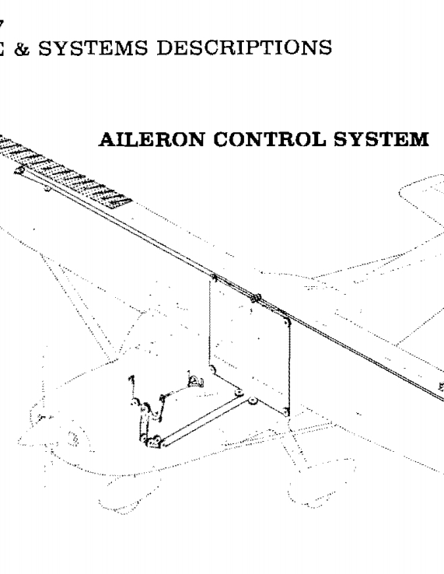
Flight Controls
Ailerons
  Differential with Friese Ailerons – connected via 3 hinges on the trailing edge
    Used to roll the aircraft around the longitudinal axis (nose to tail)
  Actuated by a series of pulleys, cables and pushrods that are connected through the control wheel

Slide 5
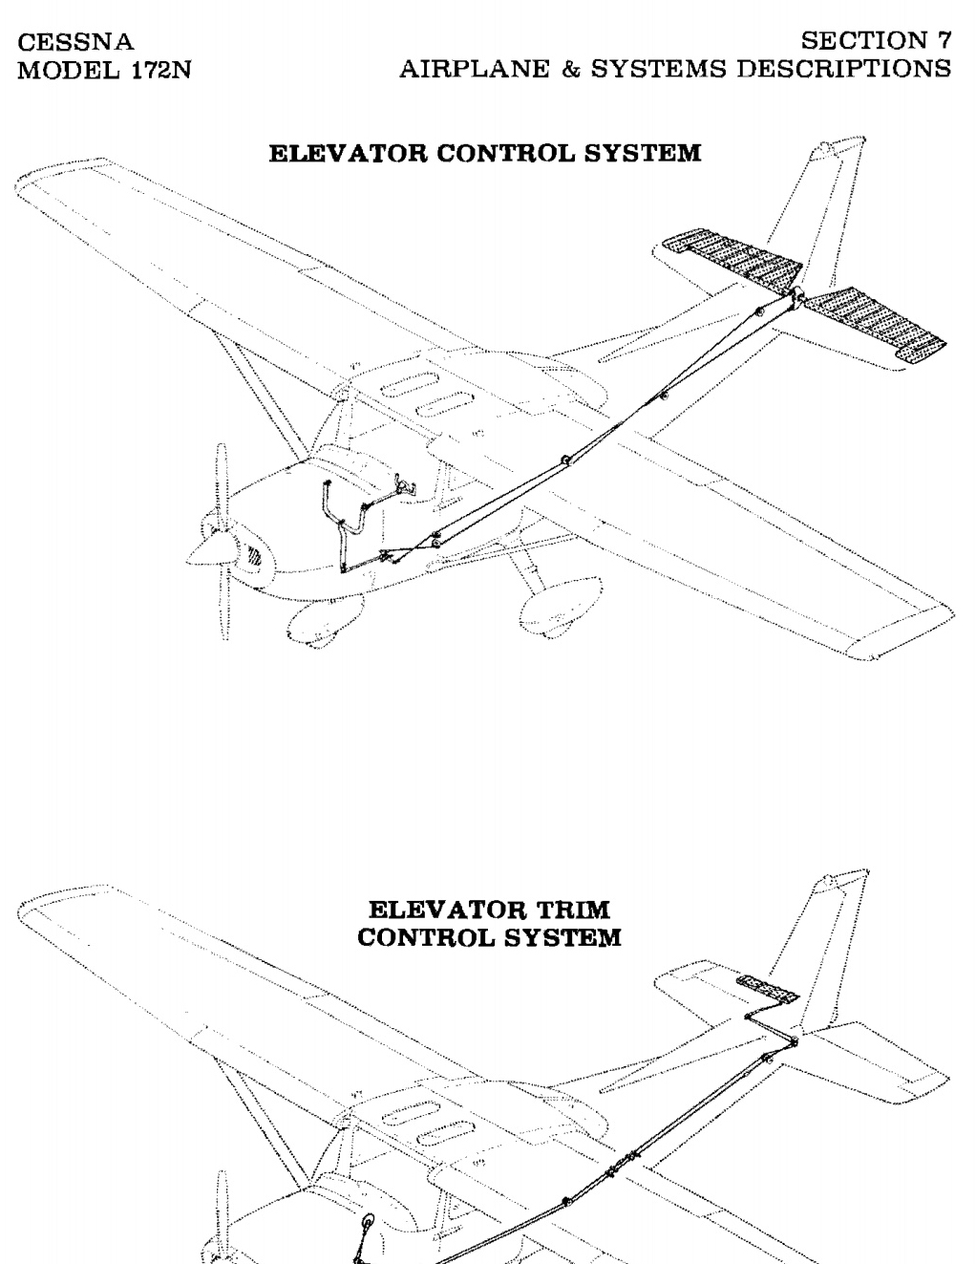
Flight Controls
Elevators
  Constructed of aluminum sheet metal on the trailing edge of the horizontal stabilizer
  Used to provide changes of pitch along the lateral axis (wing tip to wing tip)
  Actuated by a series of pulleys, cables and pushrods that are connected through the control wheel
Elevator Trim
  Constructed of aluminum sheet metal on the right rear trailing edge of the elevator
  Used to alleviate pressures for the pilot on the control wheel for airspeed
  Actuated by a series of pulleys, cables and pushrods that are connected through the trim wheel

Slide 6
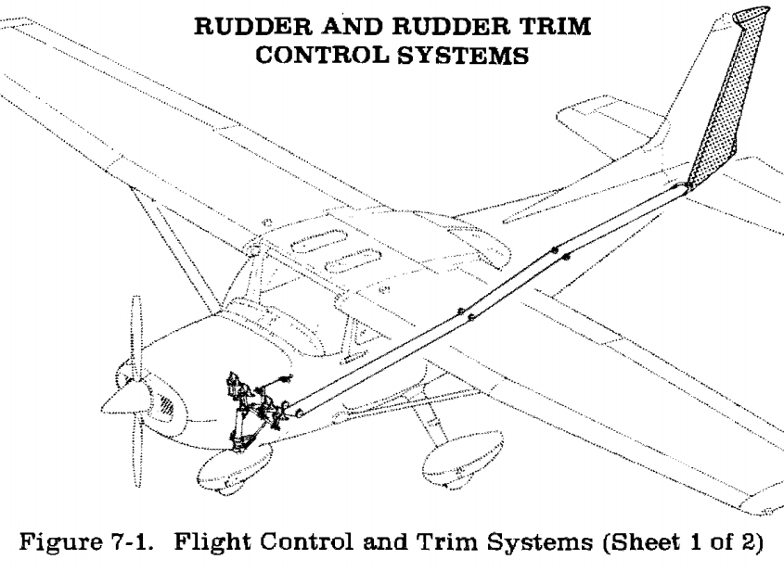
Flight Controls
Rudder
  Constructed of formed leading edge skin containing hinge valves. Located on the trailing edge of the vertical stabilizer on the empennage (tail assembly)
  Used to turn or yaw the aircraft around the vertical axis (top to bottom)
  Actuated by a series of pulleys, cables and pushrods that are connected through the rudder pedals in the pilot foot wells

Slide 7
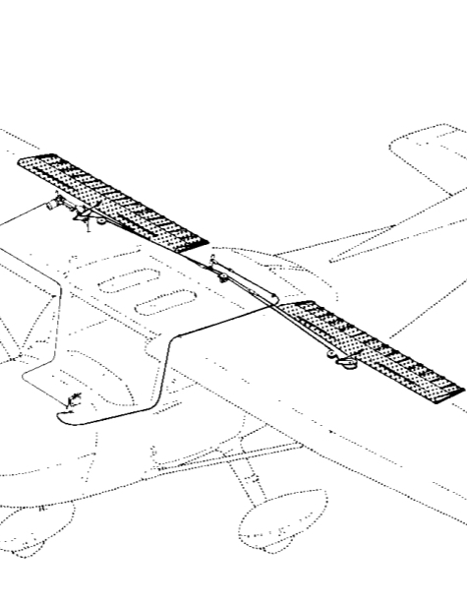
Secondary Flight Control
Wing Flaps
  Designed as a single slotted flap (a lift device)
  Attached by two rocker arms along rollers and one mechanical push rod along the trailing edge of the wing root
  Electronically actuated with 10, 20, 30, and 40 degrees of movement
  Used to provide lift and achieve steeper descent angles without sacrificing speed

Slide 8
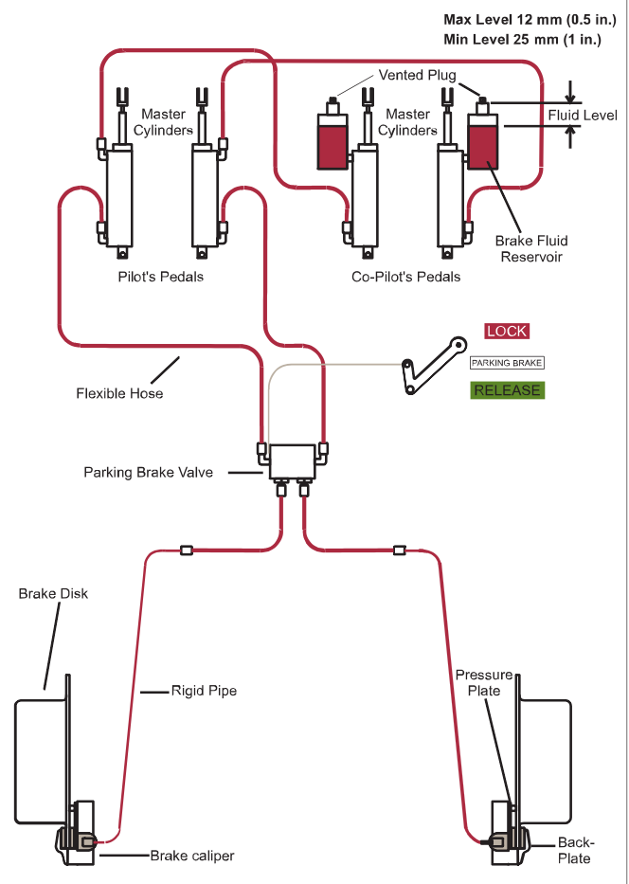
Landing Gear and Hydraulic Brakes
Fixed gear, tricycle type made of flex tubular sprung steel for shock absorption (main wheels)
Nose gear is an oleo (air/oil) strut for shocking absorption.
  Nose gear is connected to rudder pedals for nose wheel steering via a spring-loaded bungee.
Brakes are actuated by red hydraulic brake fluid. Master cylinders are located behind the rudder pedals were pressure is applied to move the fluid throughout the system. Consist of a single disc brake with two pads per disc providing stopping power

Slide 9
Engine “L4HAND”
Lycoming O-320-H2AD rated at 160HP @ 2700 RPM
4 stoke, 4 cylinder
Horizontally opposed (“O” from O-320)
Air cooled
Naturally Aspirated (meaning no power adders like turbos or superchargers)
Direct Drive (engine crankshaft is directly connected to propeller)

Slide 10
Engine
Ignition is provided to the 320 cubic inch engine via 2 magnetos (L & R)
  Magnetos are used to distribute timing to 8 spark plugs, 2 per cylinder located on the top and bottom of each cylinder
Engine contains a dry sump oil system lubricated by 6 quarts of oil; 4 quarts is the FGA minimum. Oil system is composed of oil strainers, bypass valves, and oil coolers.

Slide 11
Electrical System
The C172 electrical system alternator is composed of a 28 Volt direct current (DC) electrical system at 60 Amps
The battery is 24 Volts.
  Alternator provides charge to battery. (Think high pressure flows to low pressure 28v – 24v)
  If alternator fails. Aircraft is electrified through the battery for a short time frame.
Current is supplied to avionics and electrical equipment through electrical buses (electrified metal tabs [buses] with currents connected) and circuit breakers

Slide 12
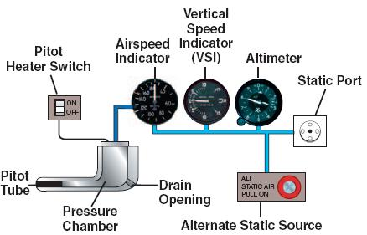
Vacuum System / Pitot Static System
Vacuum is provided to the HEADING INDICATOR and ATTITUDE INDICATOR via an engine driven vacuum pump connected to the engine. The system provides suction to keep the gyroscopic instruments erect. The overall health of the system can be read by the suction gauge.
The Pitot static system consists of pitot tube on the left wing that provides ram air pressure for the ASI. A static port which captures static air pressure around it on the left side of the engine cowling for the ALT, VSI, and ASI
  The pitot tube is directly connected to the ASI whereas the static port is connected to all three

Slide 13
Fuel System
The Cessna has two 21.5-gallon tanks located inside of the wing. 3 gallons of the fuel is considered unusable. Leaving the total usable fuel of 40 gallons
  Both tanks are vented via the fuel vent to prevent the expansion of fuel from cracking the tanks
  Fuel is gravity fed to the fuel selector. Fuel selector has four positions, (L, R, Both, Off)
  Once fuel leaves the selector, it then goes through a fuel strainer that channels fuel to the carburetor

Slide 14
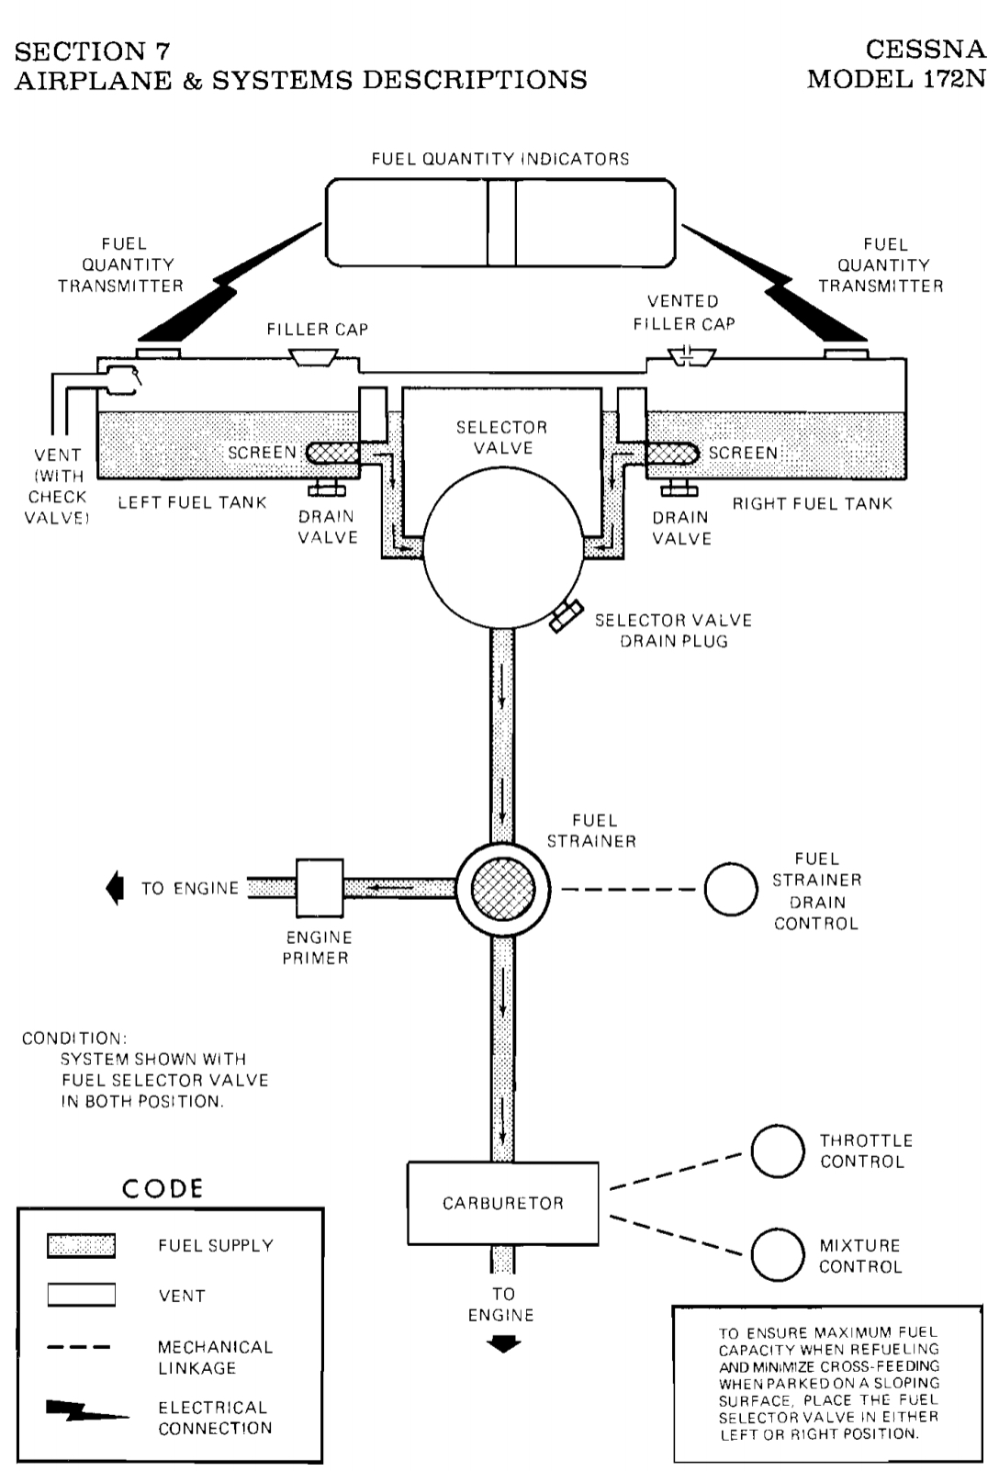
Fuel System cont’d

Slide 15
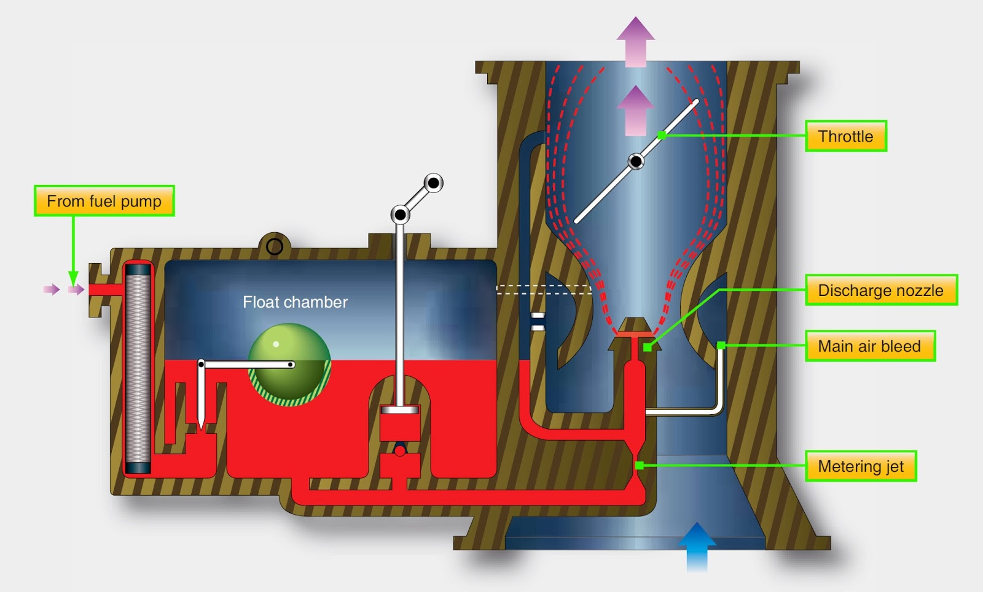
Fuel System (Carburetor)

Slide 16
Nav System
Our C172s all have a VOR receiver and GPS receiver for navigation
VOR (Very High Frequency Omnidirectional Ranging) used to fly radials from a ground based navigational aid
GPS reception is provided by the top mounted antenna through the Garmin 430 (G430). GPS uses a series of satellites to triangulate an aircraft position relative to the satellites above

Slide 17
C172 Limitations
Vne (160 KIAS) – Never exceed speed. Damage can occur, excessive fluttering and vibration from control surfaces
  Identified on ASI as the red line
Vno (128 KIAS) – Maximum Structural Cruise speed. Do not exceed this speed except in smooth air, and then only with caution. Aircraft is stressed and designed to take substantial gusts at or below Vno without damage
  Identified on ASI as yellow arc
Va (97 KIAS) – Maneuvering Speed. Speed at which you can deflect one control surface one time across one axis and the aircraft MAY stall before damage occurs.
  Changes with weight. Va = Va @ Max Gross x √(Current Weight / Max Gross Weight)

Slide 18
C172 Limitations cont’d
Vfe (110 & 85 KIAS) Maximum Flap Extension Speed. 110 for 10° and 85 with flaps from 20-40°
  Identified on ASI as the top of the white arc at 85 KIAS
Maximum Window Open Speed (160 KIAS) do not exceed this speed with windows open

Slide 19
C172 Limitations Cont’d
Tachometer – Redline at 2700 RPM
Oil Temp – 245°F
Oil Pressure – Minimum of 25 psi and Maximum of 100 psi
Maximum Ramp Weight – 2307 lbs (Normal Category)
Maximum T/O and LND Weight – 2300 lbs (Normal Category)
CG Range: FWD – 38.5 inches / AFT – 47.3 inches both at max gross
Flight Load Factor at Max Gross: +3.8g and -1.52g

